Slide 1
Mora
Low-fi Prototype and Test

Slide 2
Mora
More amusement. More acquisition. Mora.

Slide 3
Problem & SOlution
The value proposition of Mora is to save the language learner of all levels who loves watching TV and movies from the tedious, decontextualized language learning techniques of old.
Mora is a companion for streaming which interrupts your watching with live language lessons and links to an app which summarizes your stats, curates review material for your favorite shows, and connects you to interest-based communities of language learners to bond and/or compete live with.

Slide 4
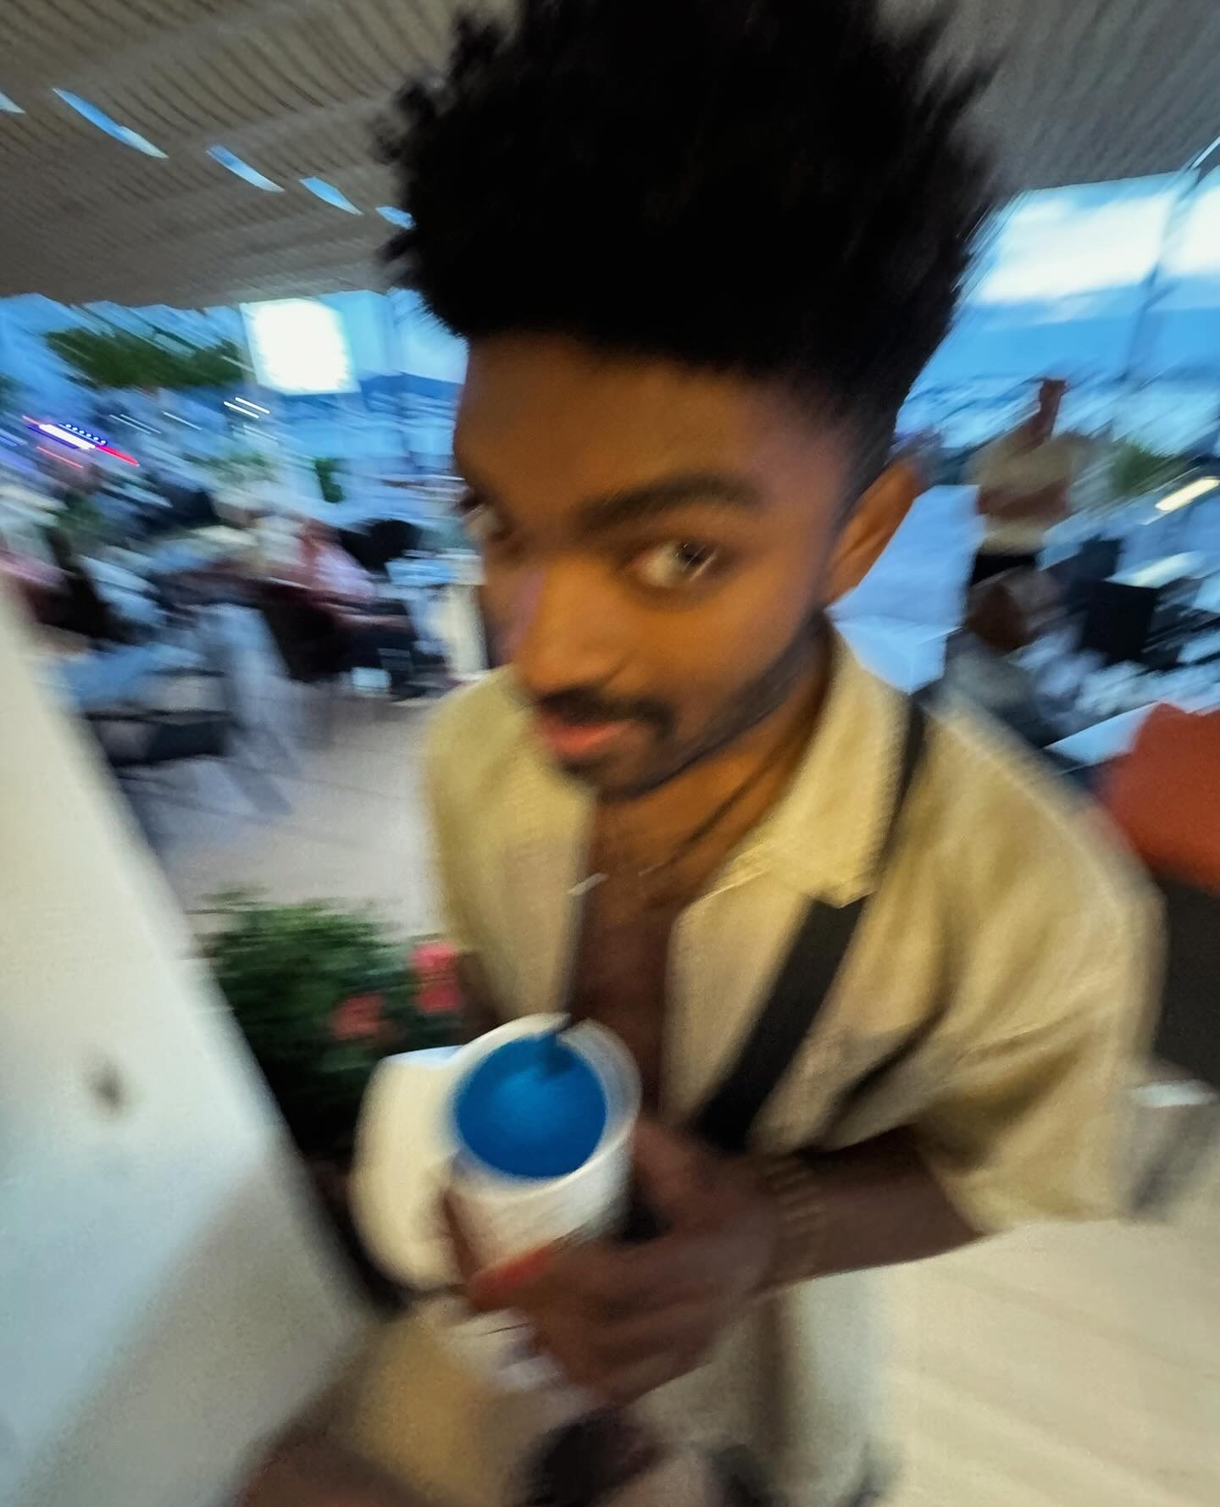
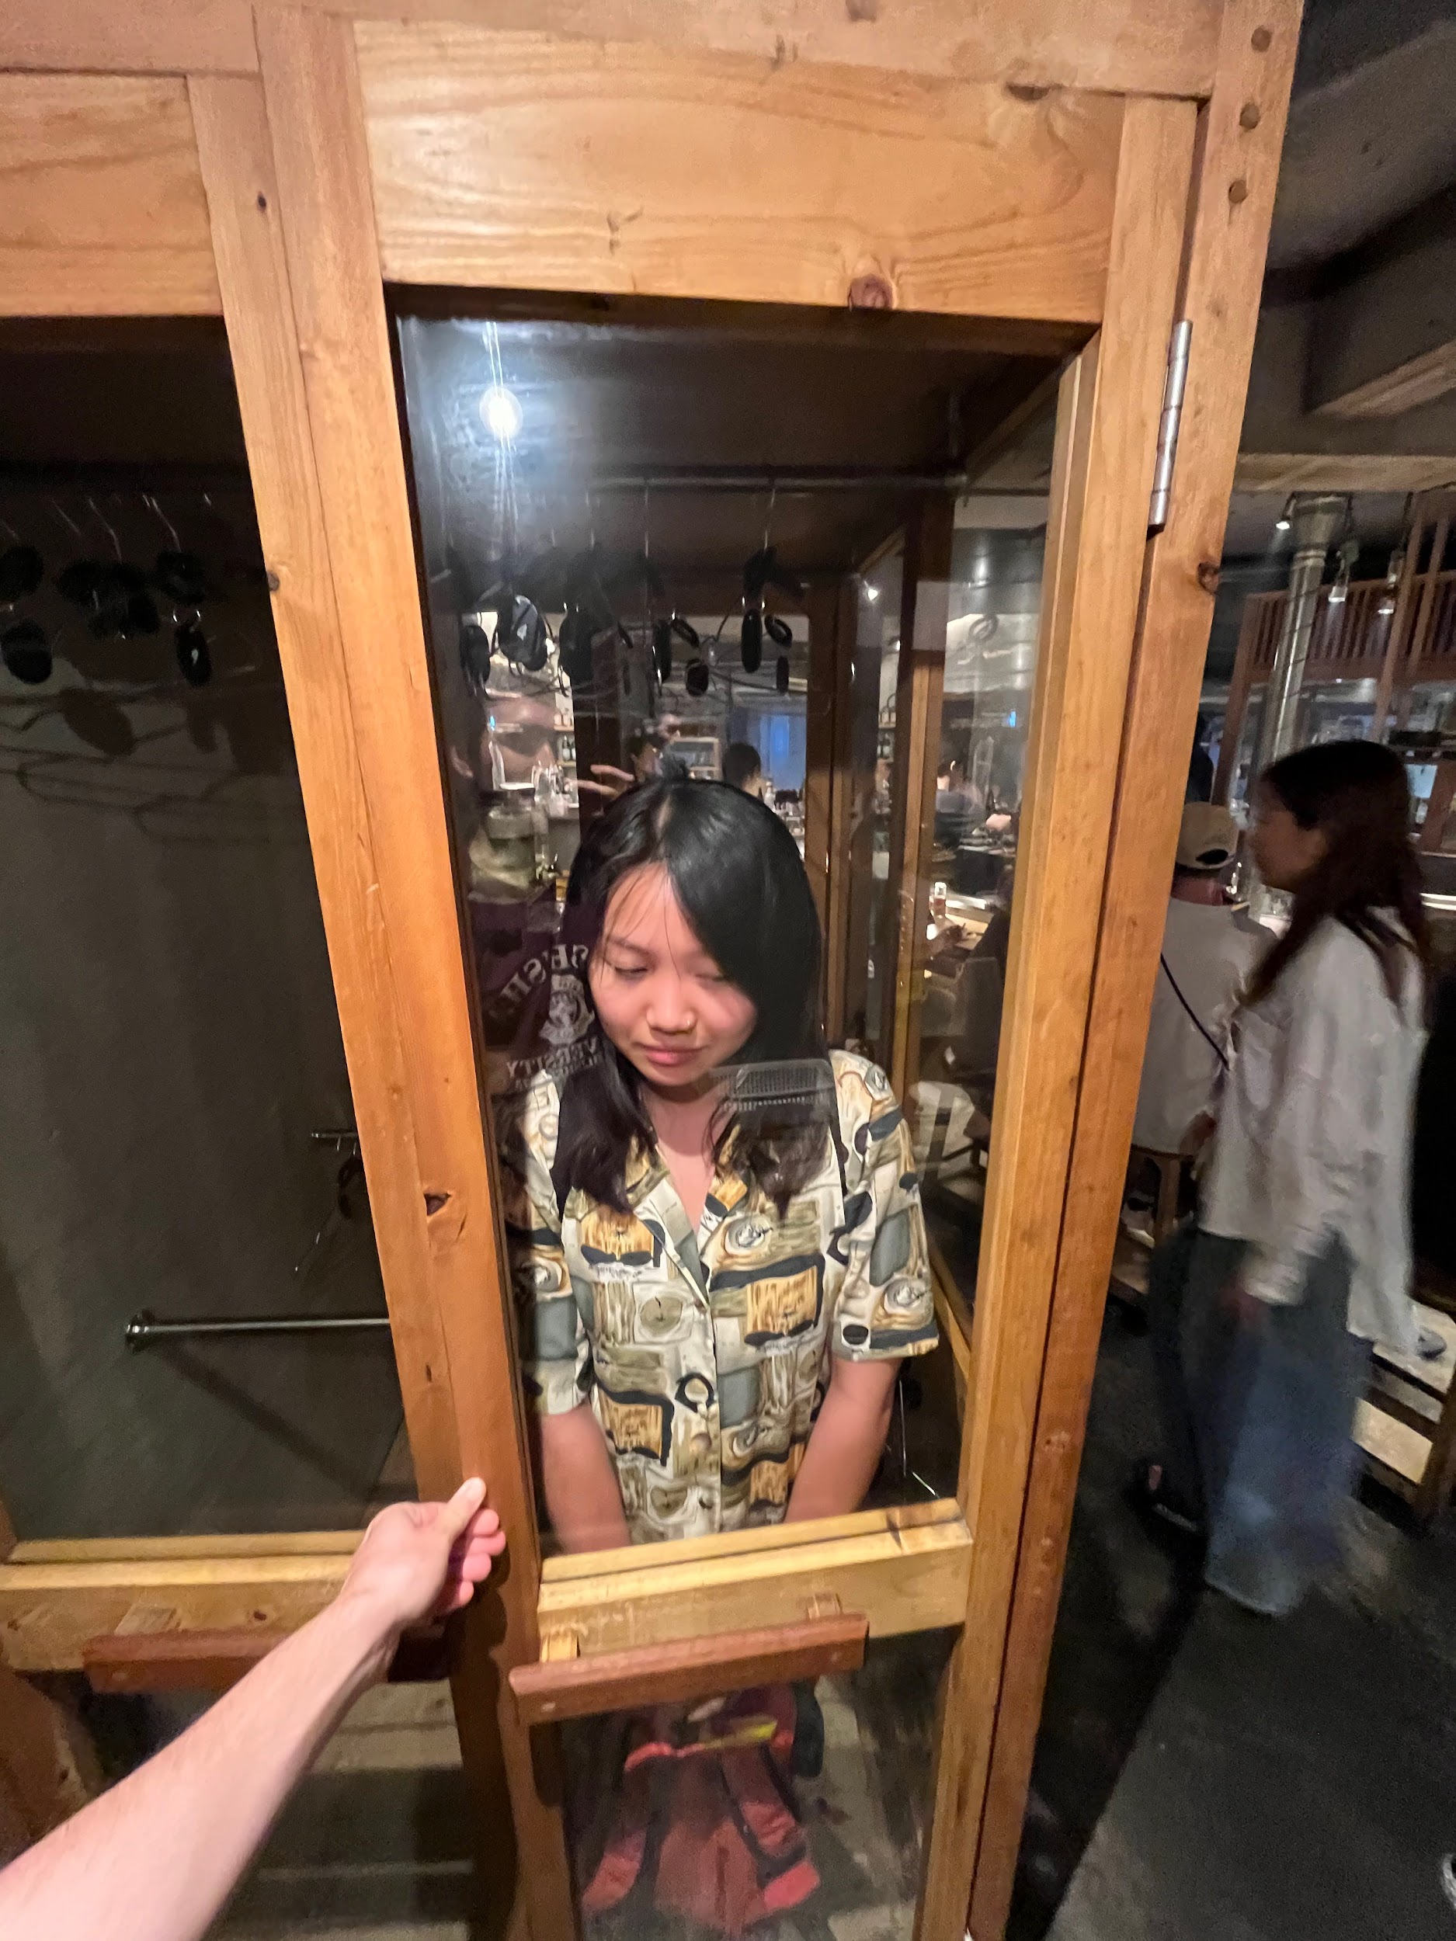
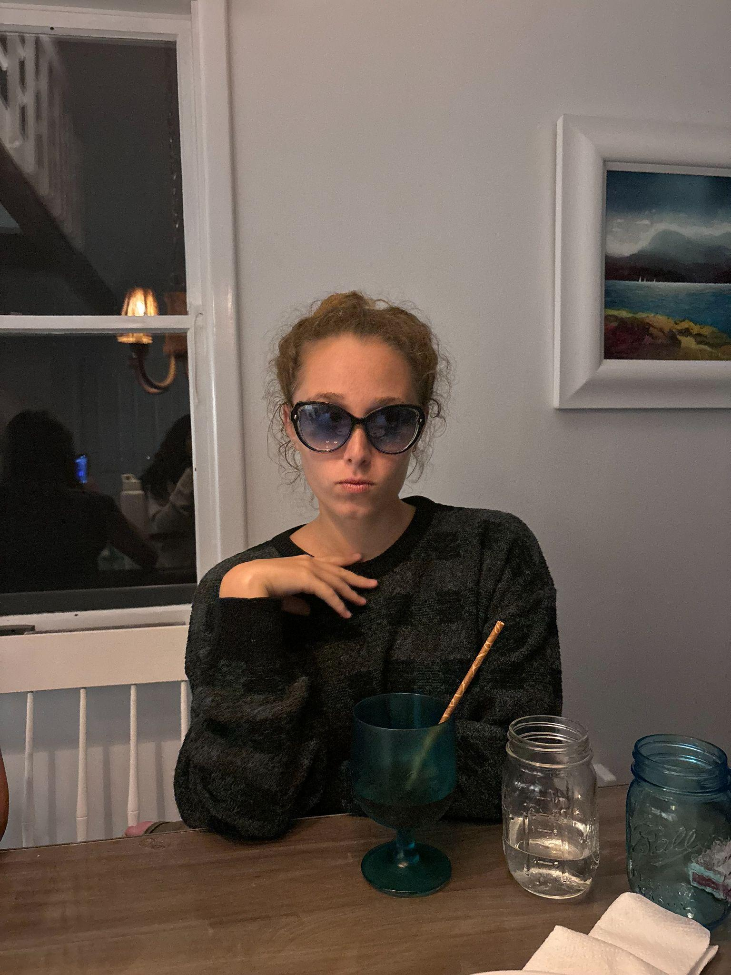
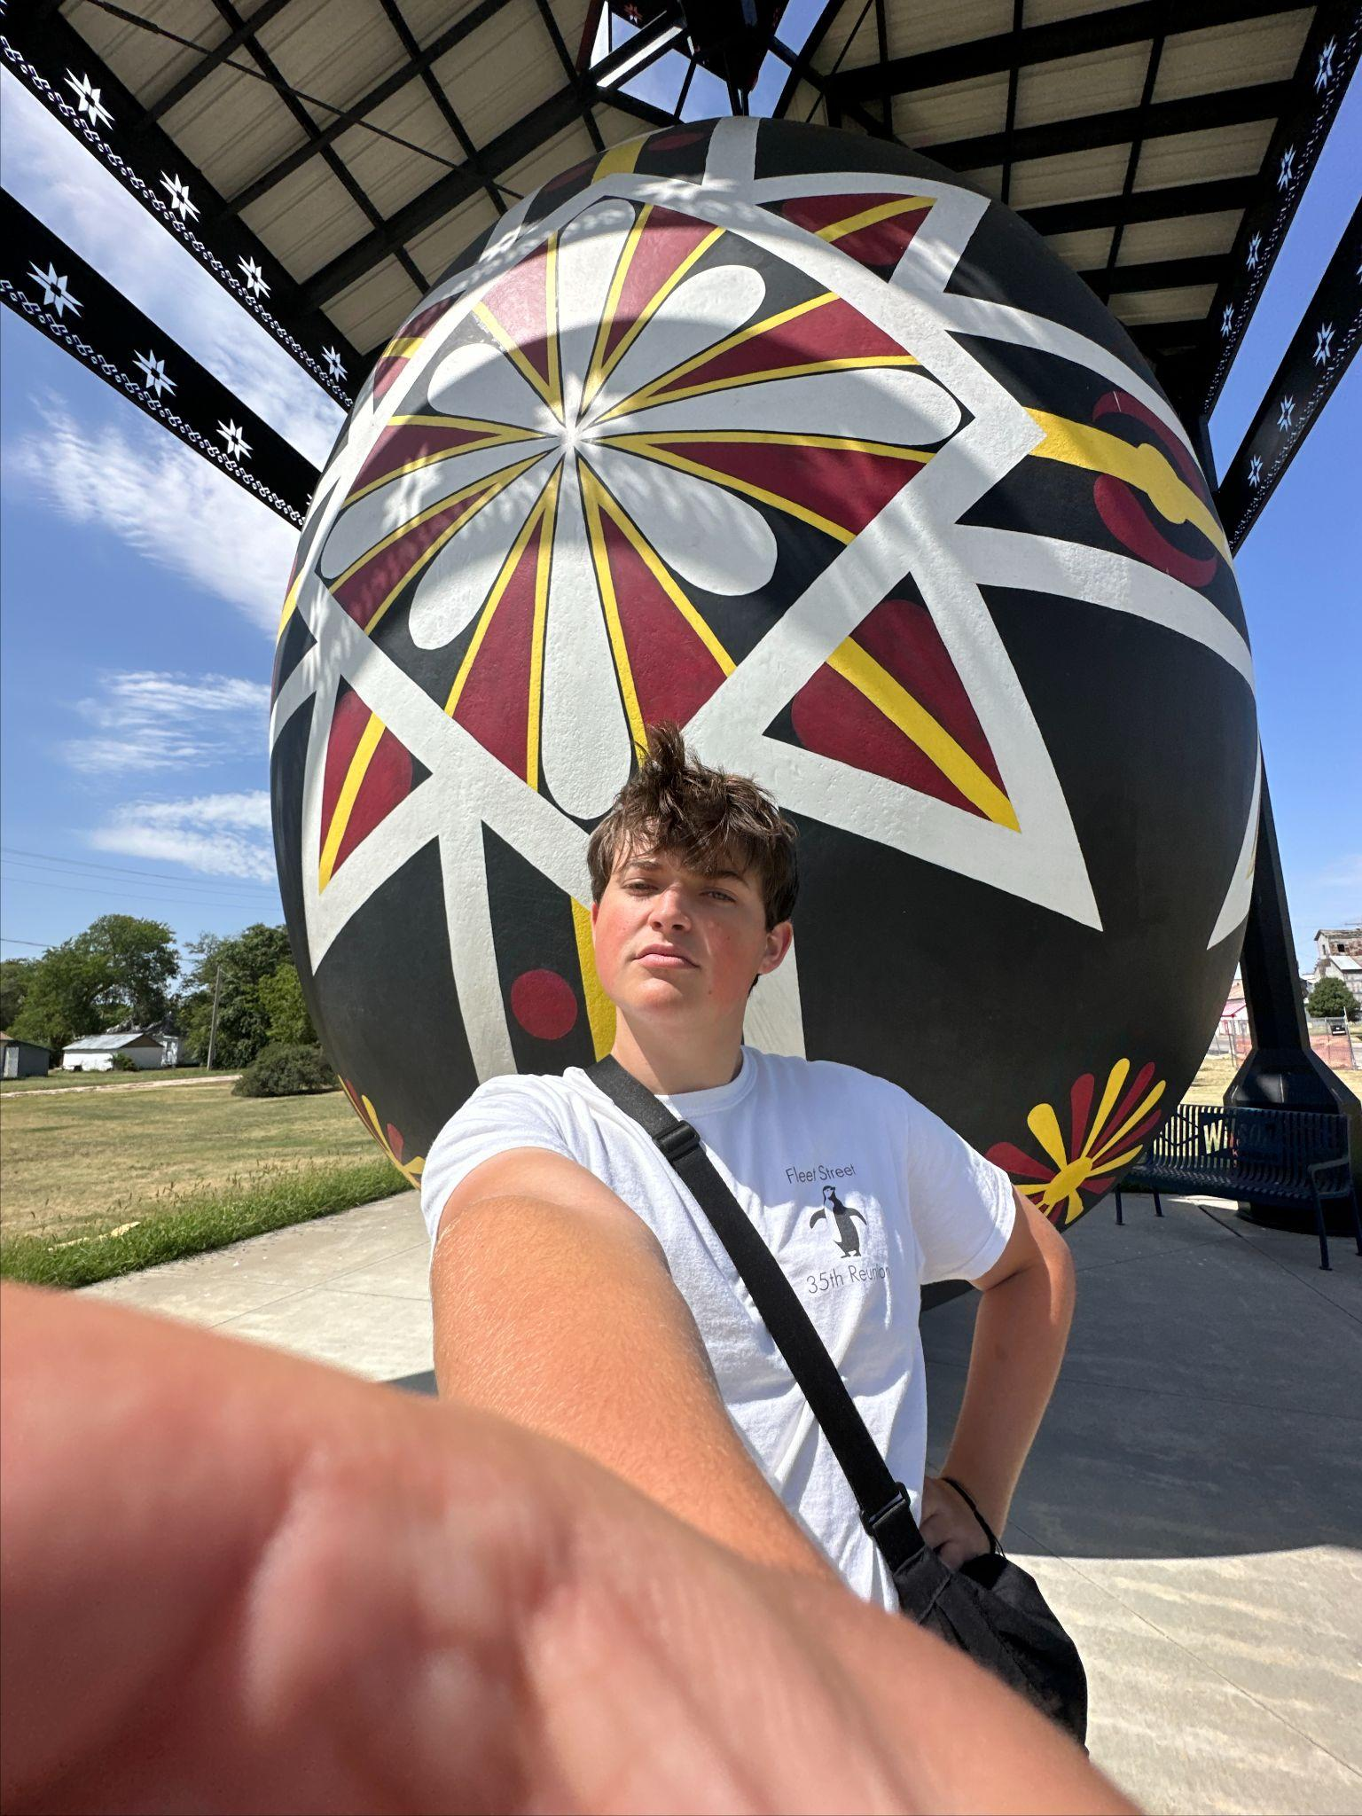
Our team
Bryant
Candy
Lulu
Tommy
Senior
Computer Science
Senior
Urban Studies
Junior
Computer Science
Junior
Undeclared

Slide 5
Table of contents
01
02
Concept sketches
Key Screens
03
04
Task Flows
Paper prototype
Phone, Tablet, VR
Phone and Tablet
Simple, Moderate, Complex on the Phone
Testing Our Design

Slide 6
01
Concept sketches
Phone, Tablet, VR

Slide 7
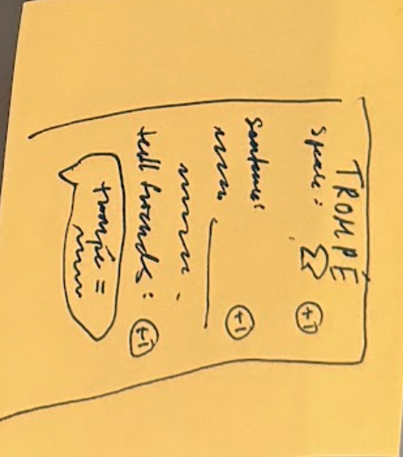
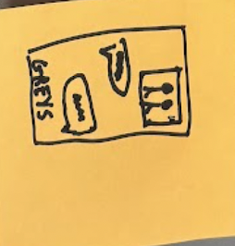
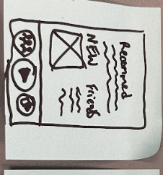
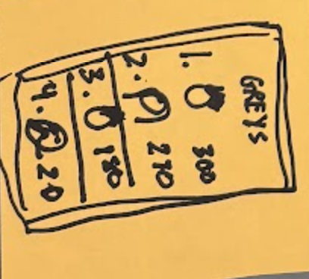
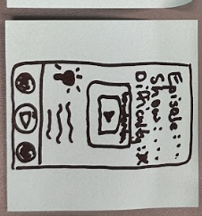
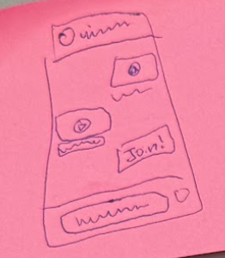
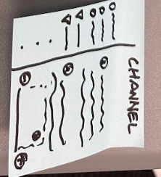
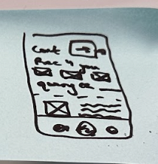
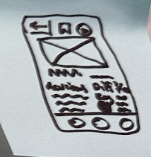
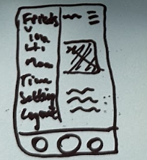
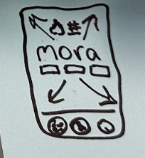
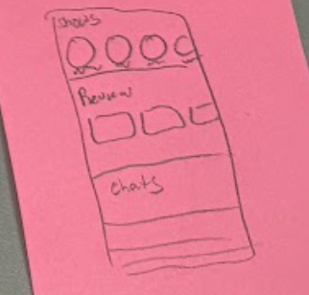
Phone

Slide 8
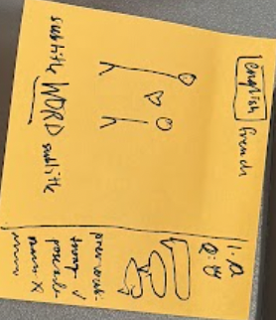
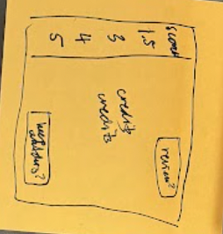
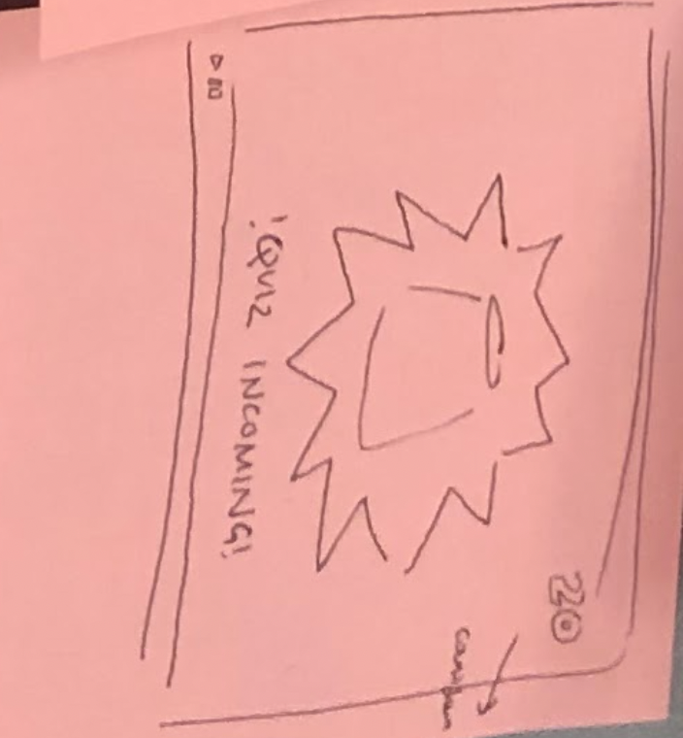
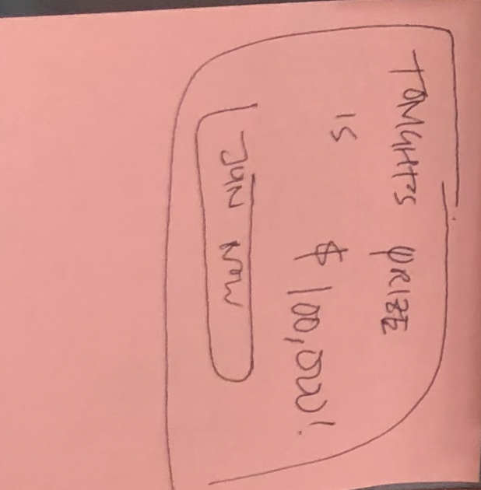
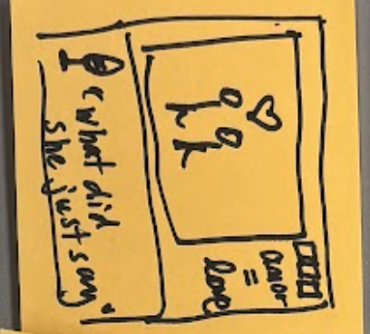
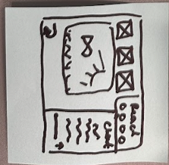
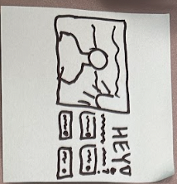
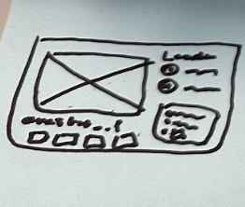
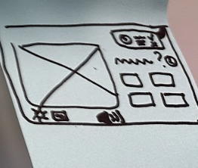
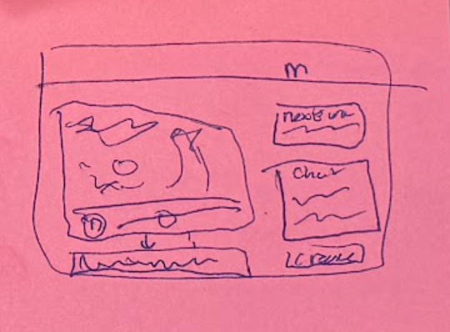
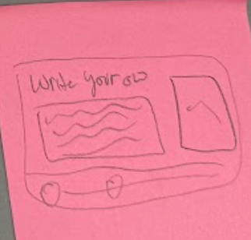
Tablet

Slide 9
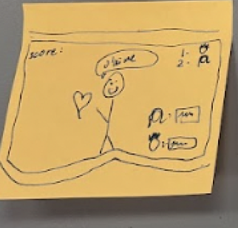
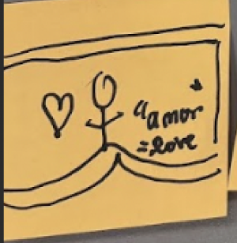
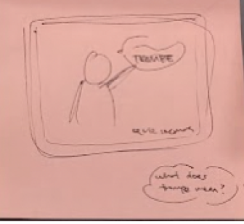
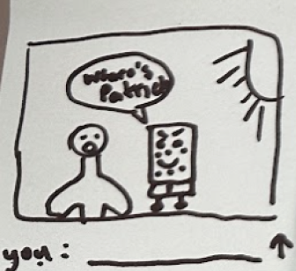
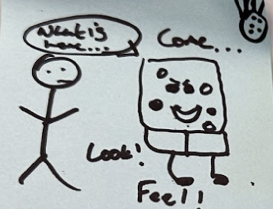
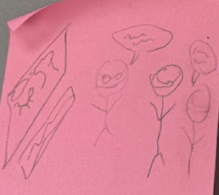
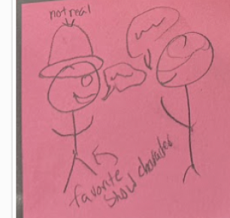
Virtual reality

Slide 10
Phone, Tablet
To keep our solution accessible and applicable to everyday life…

Slide 11
02
Key Screens
Fleshed Out Phone, Tablet

Slide 12
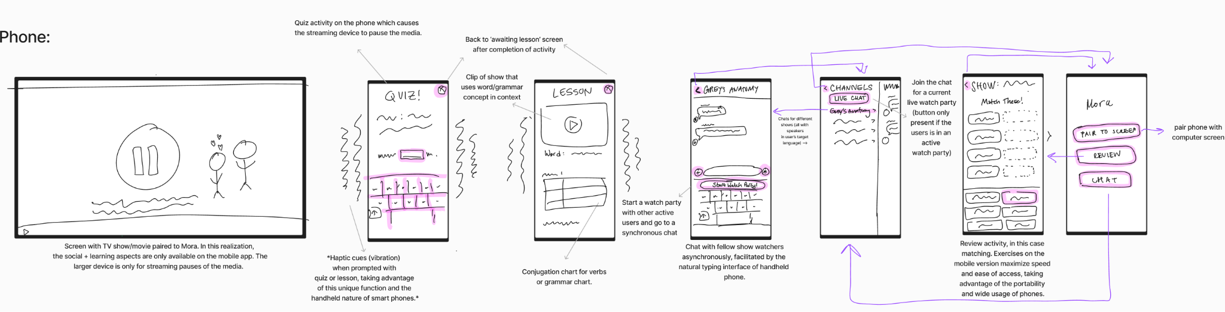
Phone

Slide 13
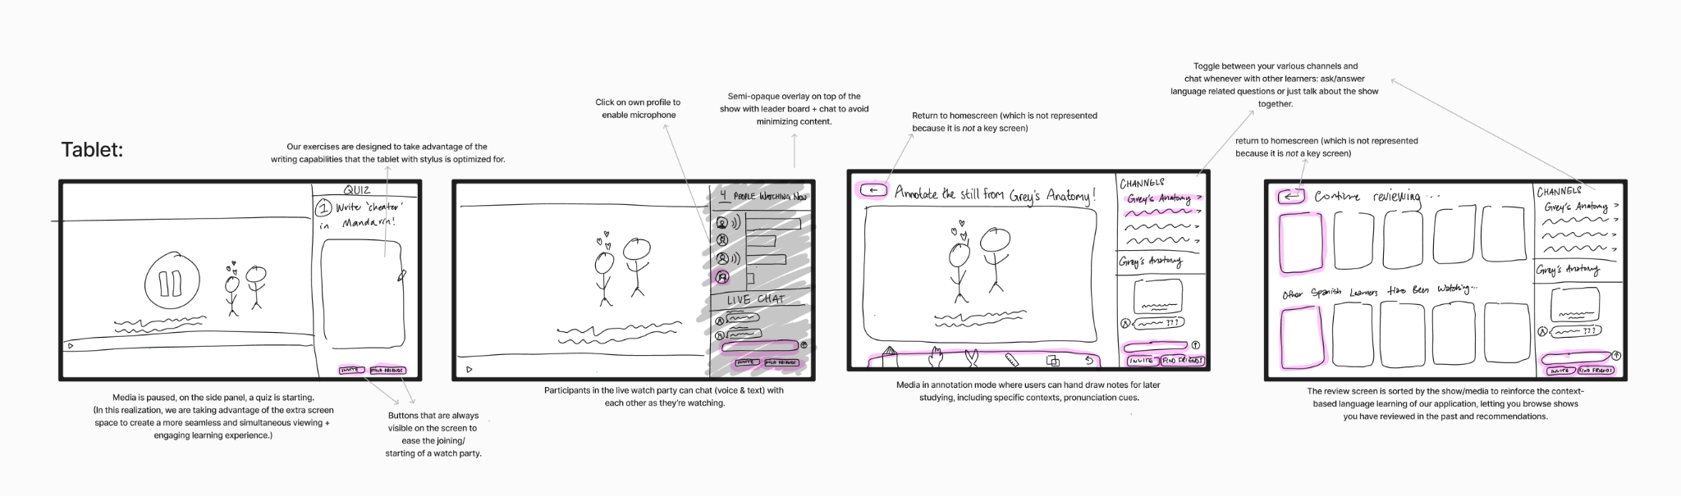
Tablet

Slide 14
Making a decision

Slide 15
Phone
Pros
Cons
Portable and natural for users to grab
Typing (to chat) is easy
Multiple users can pair to same screen
Smaller screen for learning experience
Users who want to learn languages with handwritten characters are excluded
Notes:
Pick most relevant ones

Slide 16
Tablet
Pros
Cons
Users only have to focus on one screen to see everything
Users can hand-write
More innovative learning experience with more screen space
Less people own tablets – excludes learners of lower socioeconomic status
Tablet is less portable, limiting asynchronous learning
Notes:
Pick most relevant ones

Slide 17
97.6%
48.4%
(us survey respondents)
own a smartphone
own a tablet
We Are Social, & Hootsuite, & DataReportal. (February 22, 2024). Share of digital device owners in the United States in 2024 [Graph]. In Statista. Retrieved October 25, 2024, from https://www.statista.com/statistics/1425094/digital-device-ownership-us/
Notes:
https://www.statista.com/statistics/1425094/digital-device-ownership-us/#:~:text=A%202024%20survey%20conducted%20in%20the%20United,said%20to%20have%20a%20smart%20home%20device.

Slide 18
PHONE
Our Choice:

Slide 19
Why phone?
We want Mora to be accessible to users regardless of socioeconomic status.
We want Mora to be a tool you take everywhere that is natural to use in your downtime.

Slide 20
03
Task
flows
Simple, Moderate, Complex

Slide 21
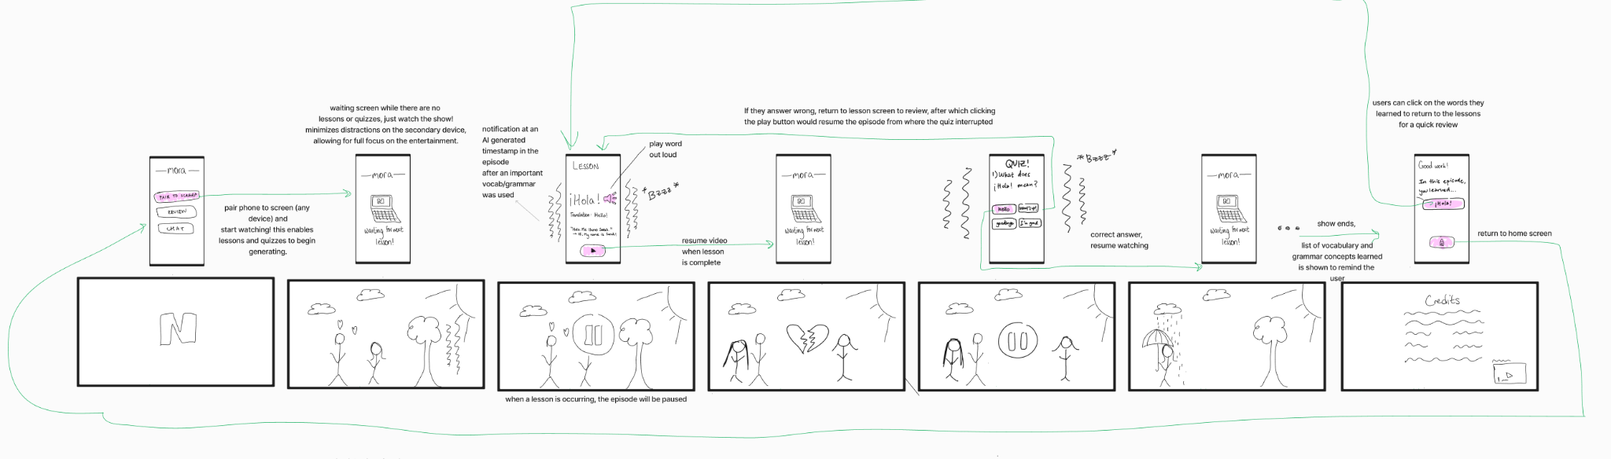
Simple task:
Engage with entertainment of choice and learn from the interactive lesson.

Slide 22
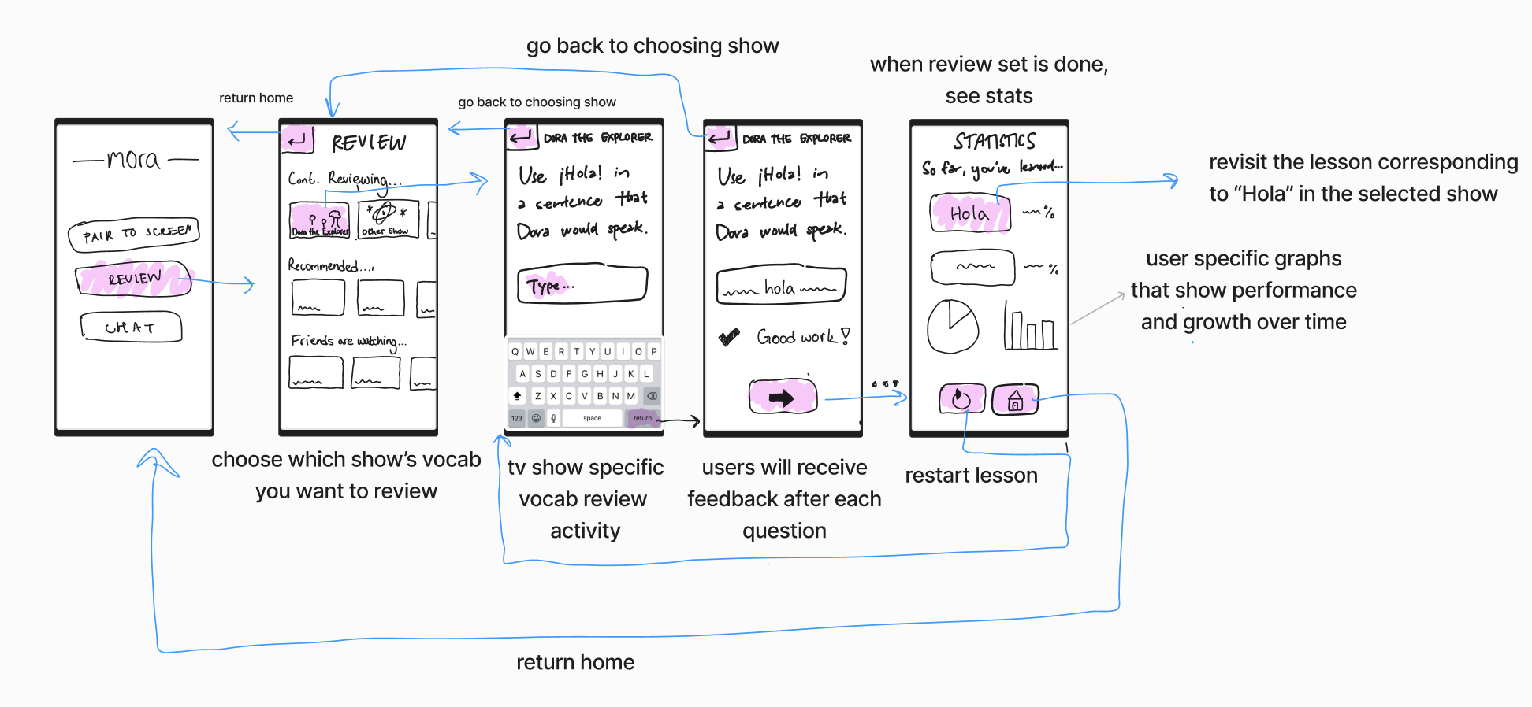
Moderate task:
Review previously seen material through in-app practice.

Slide 23
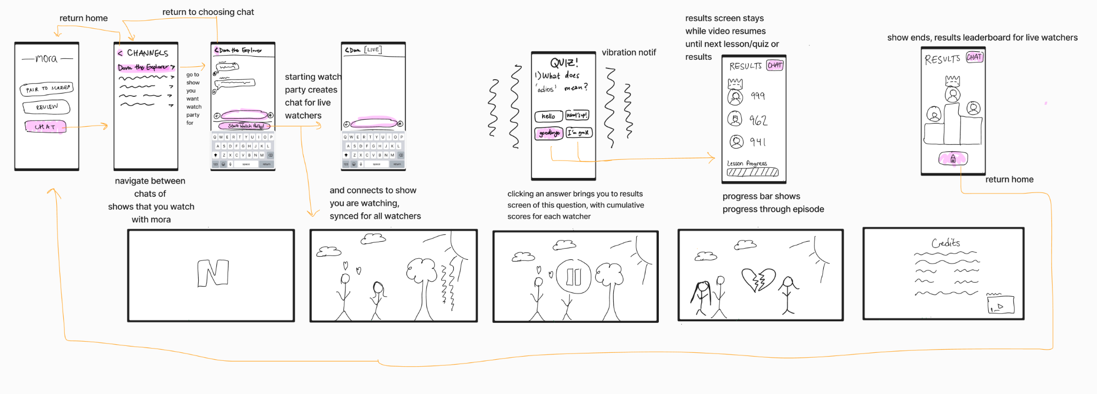
Complex task:
Organize a synchronous, optionally competitive watch party for your media-language community.

Slide 24
03
Paper Prototype
Construction, Testing, and Results

Slide 25
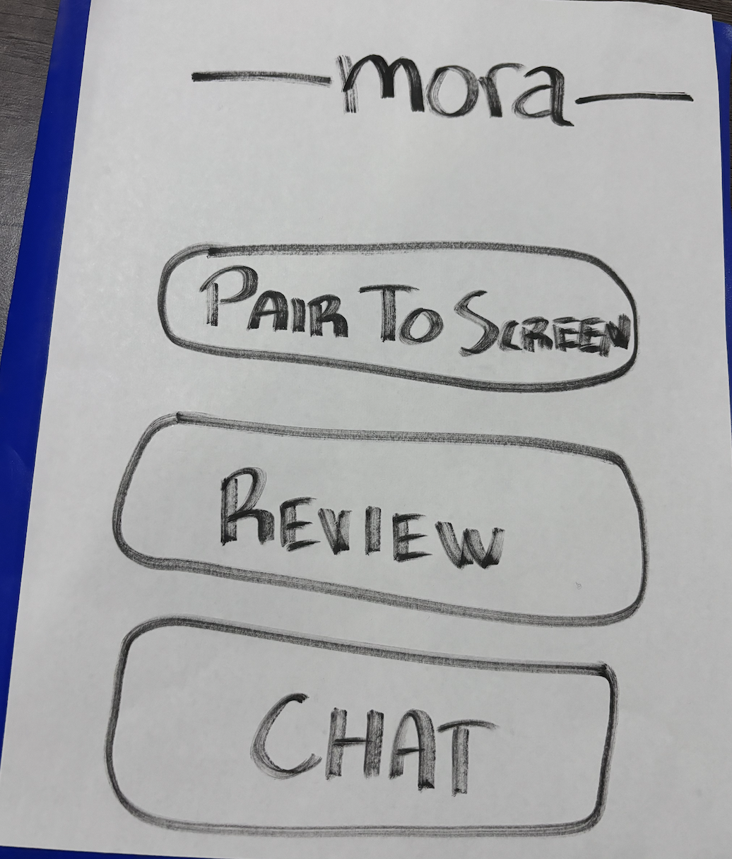
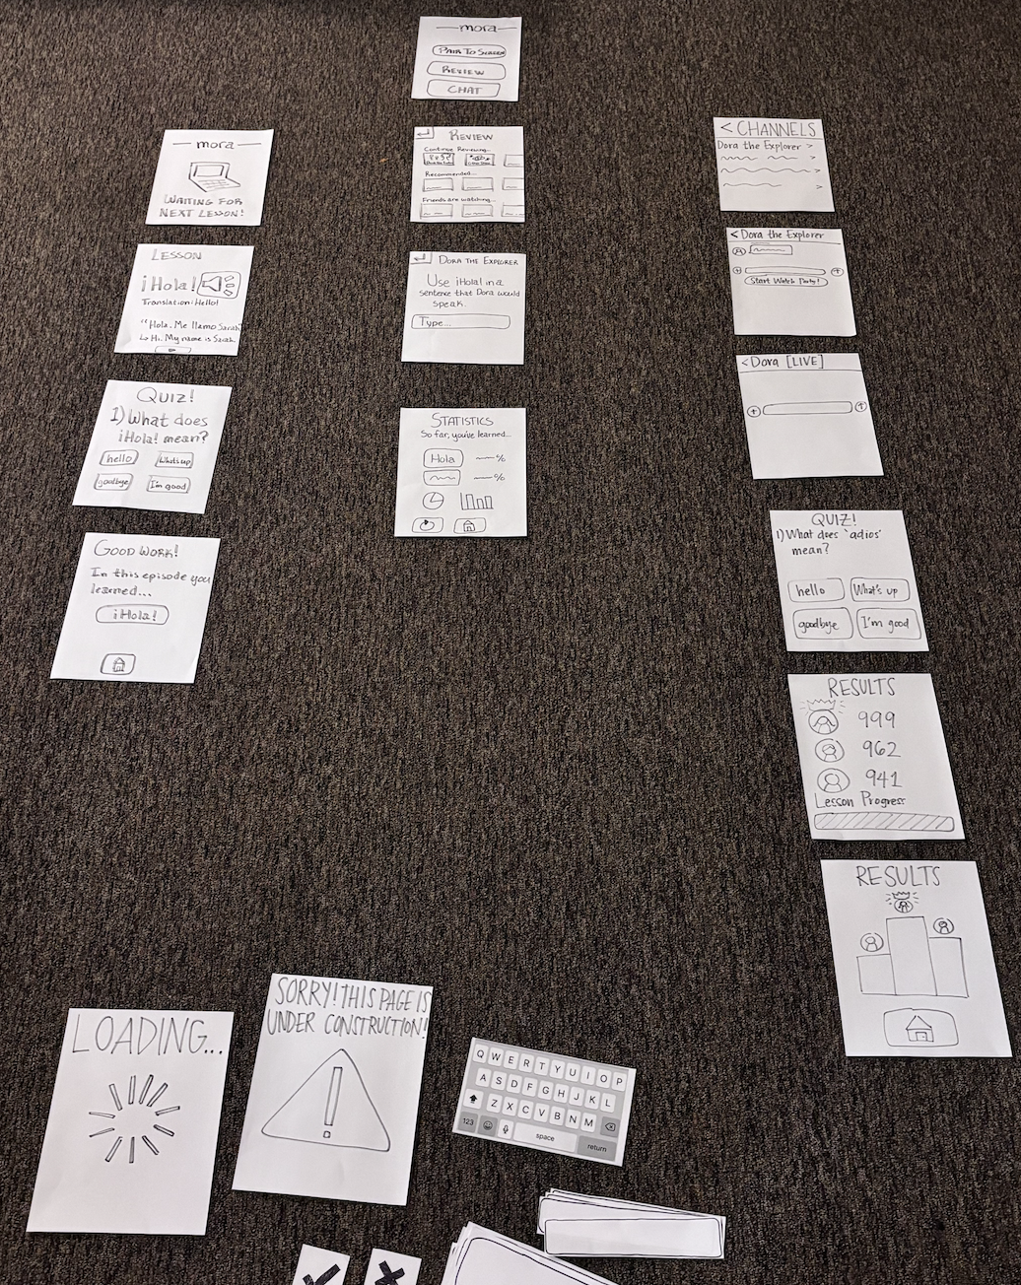
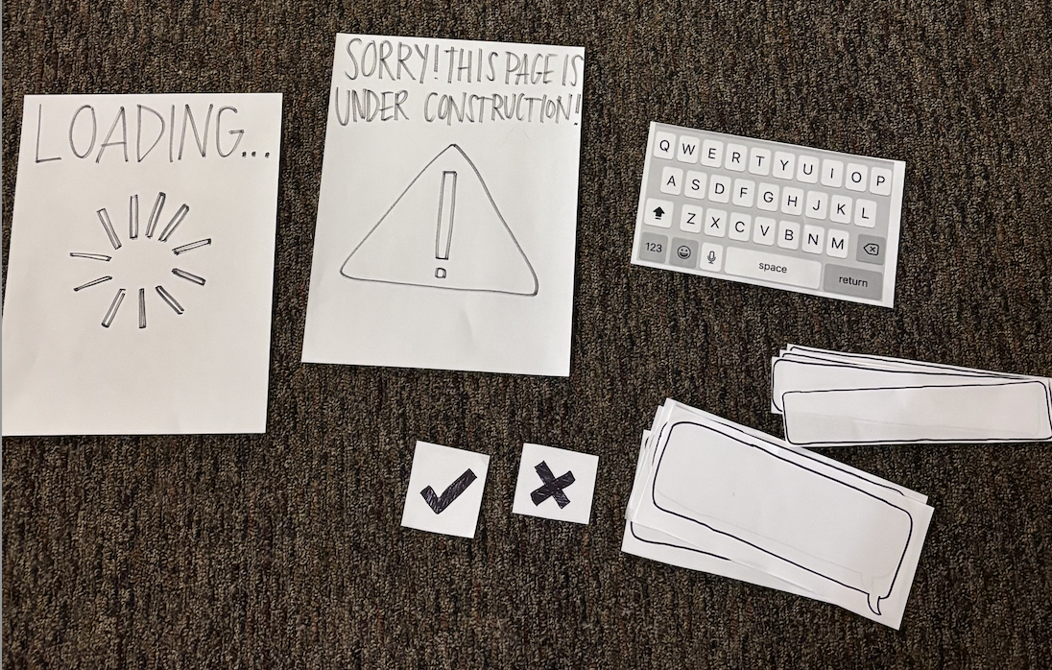
Construction

Slide 26
Testing
Participants, Prototype, Procedure, Goals

Slide 27
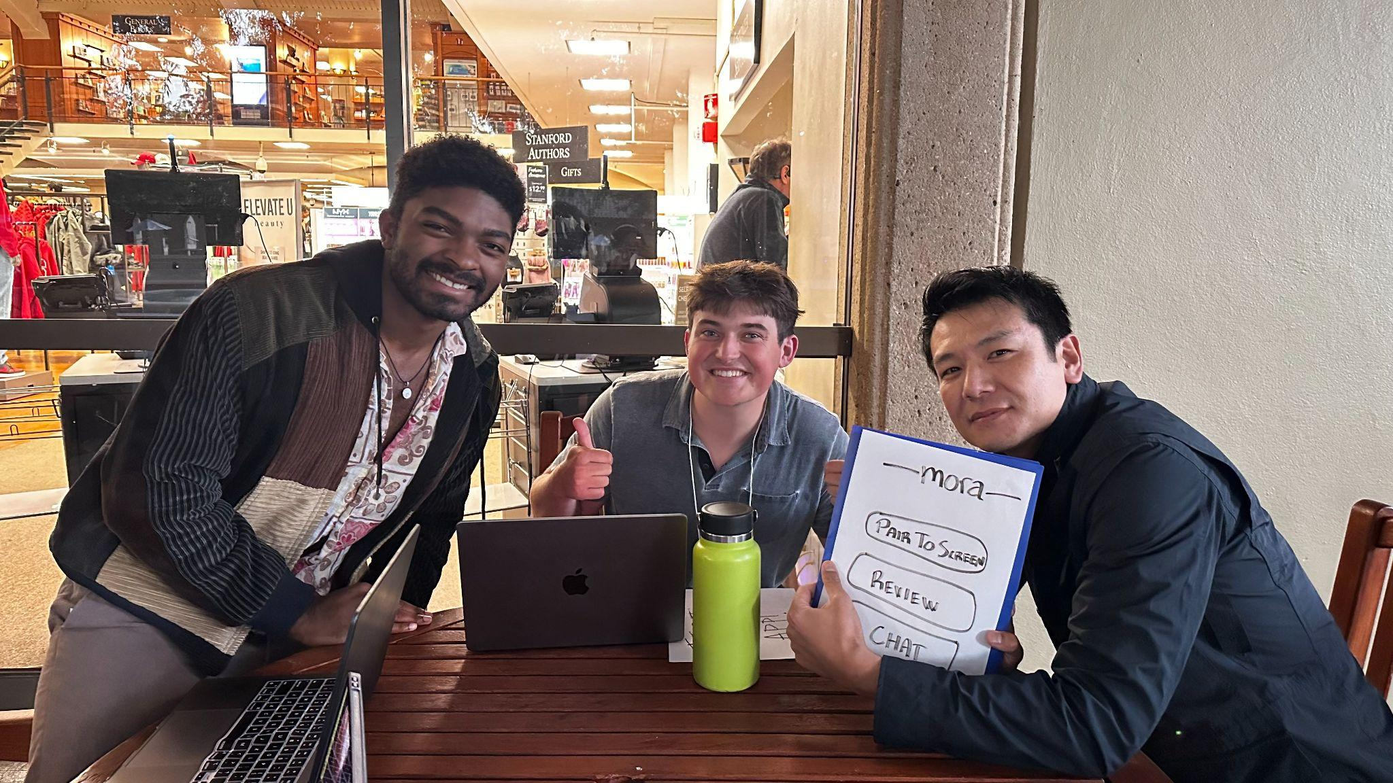
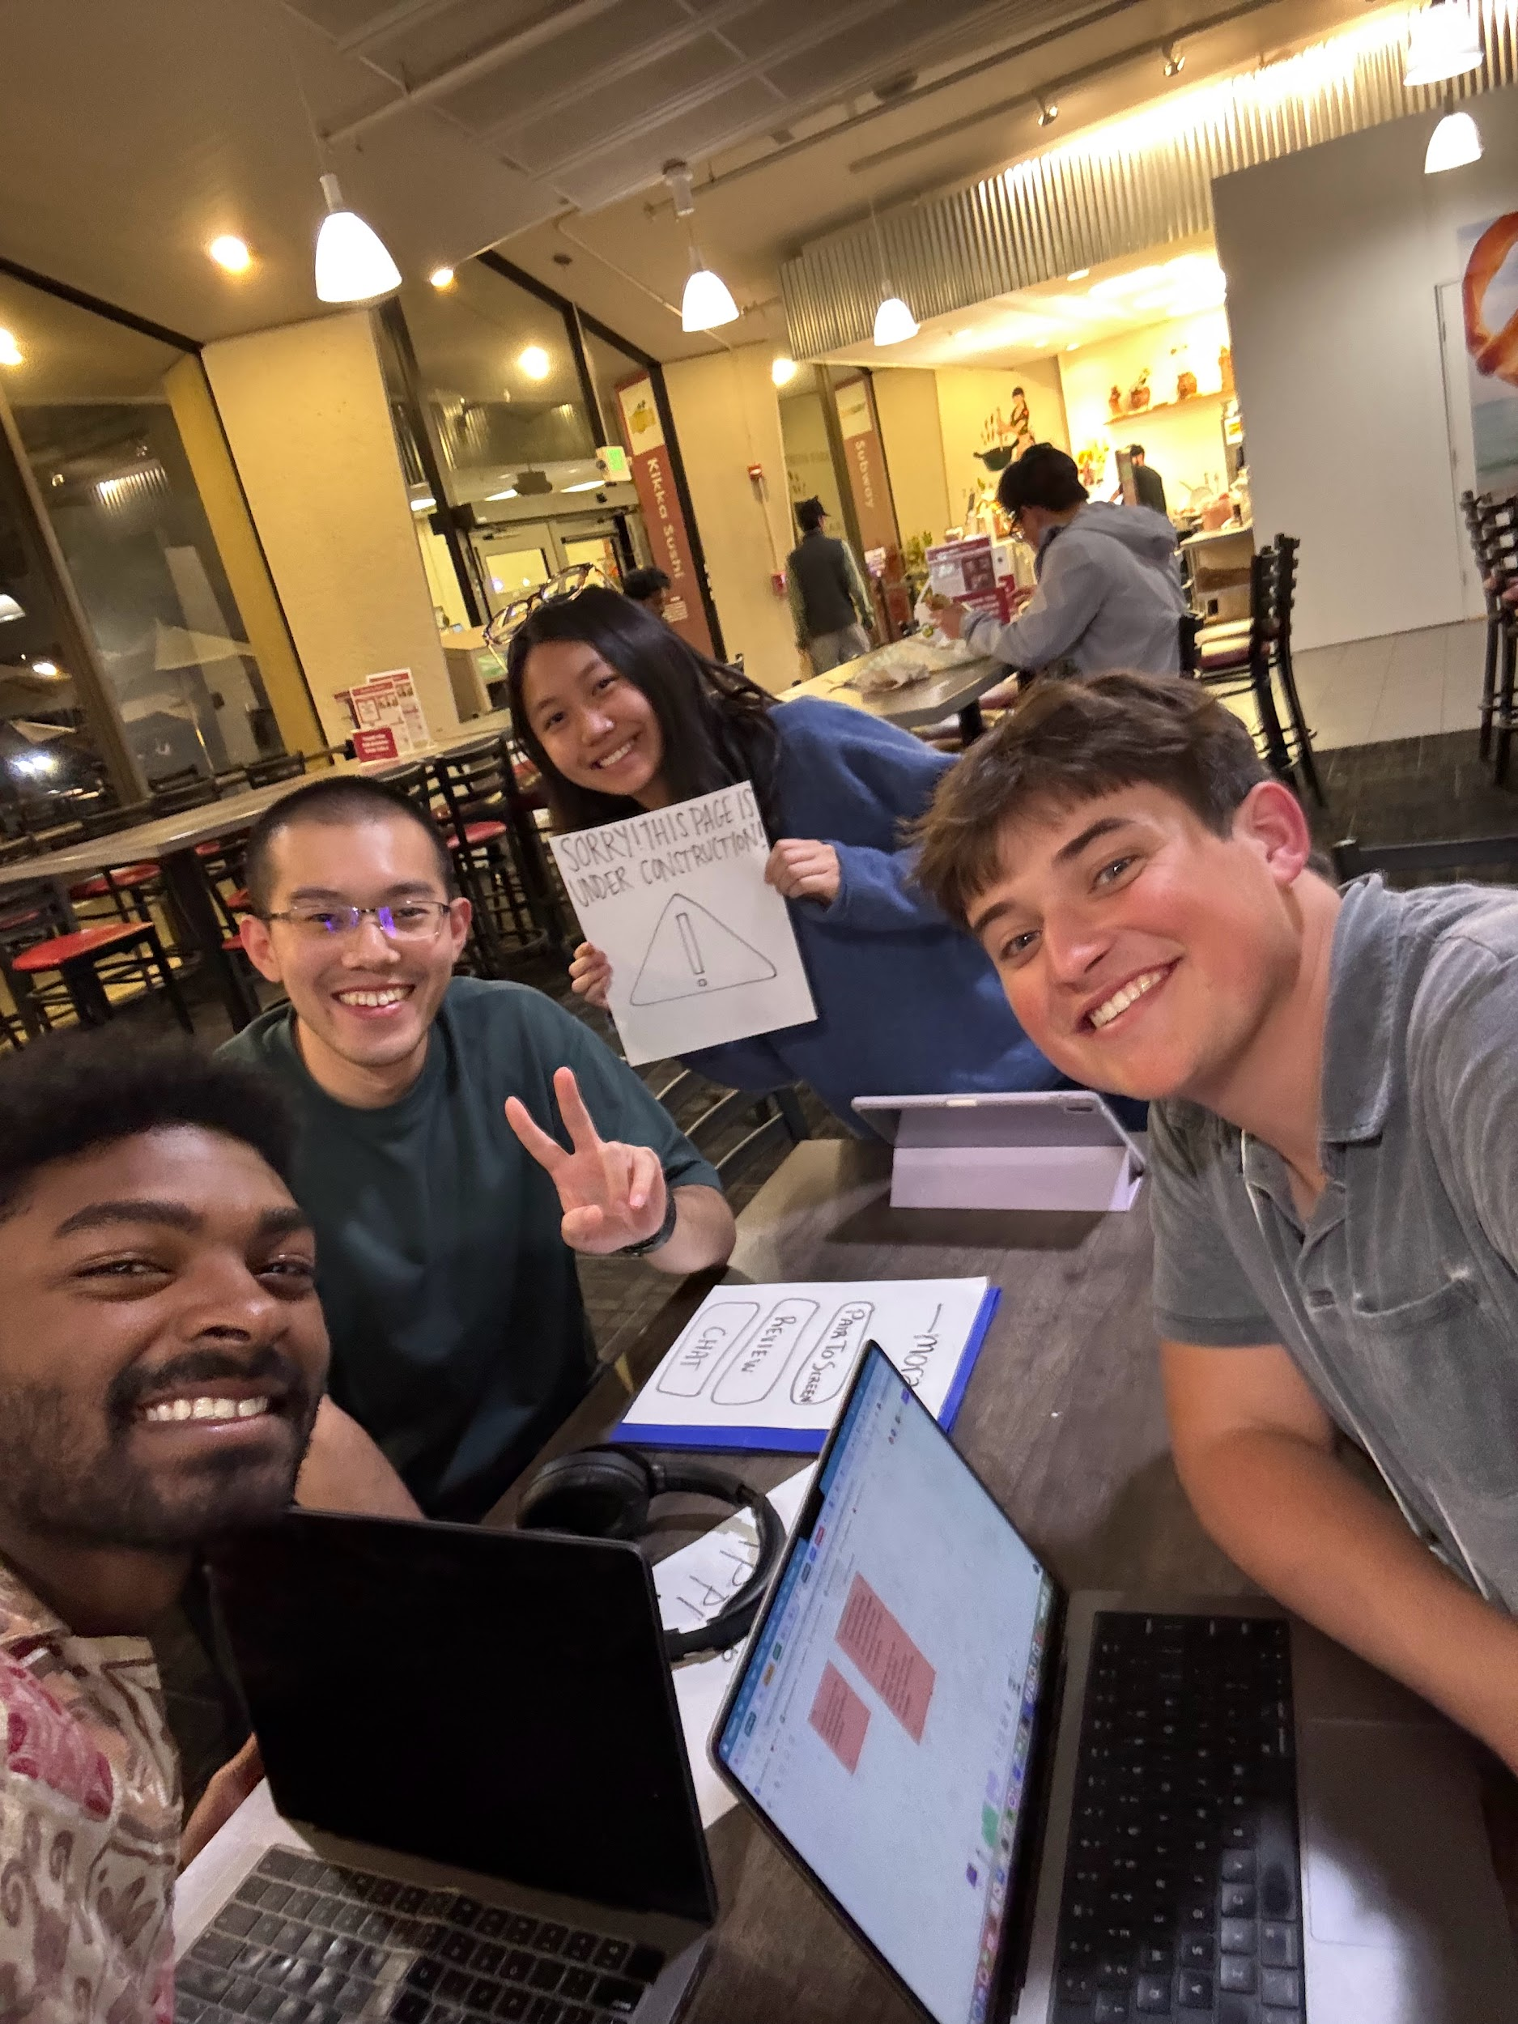
Participants
Tony
Blaine
Vanessa
Bill
A mid-40 year old stay-at-home father here for his wife’s Stanford reunion.
A civil engineer in his late 20s who immigrated from China.
A former legal professional who watches international TV.
A campus security guard in his mid 60s who picks up languages on the job.
Notes:
Recruited around campus, asking around if people were willing
Compensated by keeping in touch on our project
Demographics: all late twenties to mid sixties, two white people, two east asian people, 1 woman, 3 men
Environment: outside at white plaza or inside at tressider marketplace

Slide 28
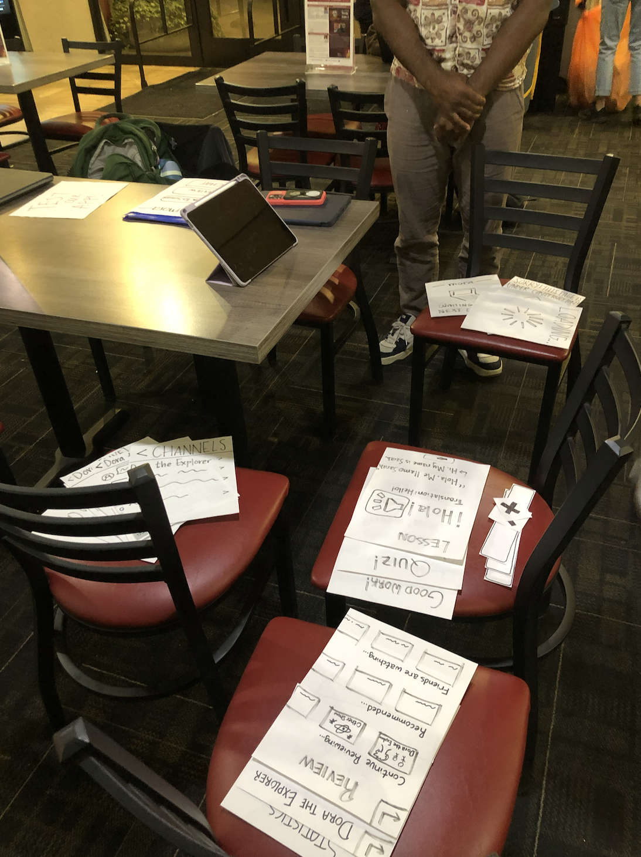
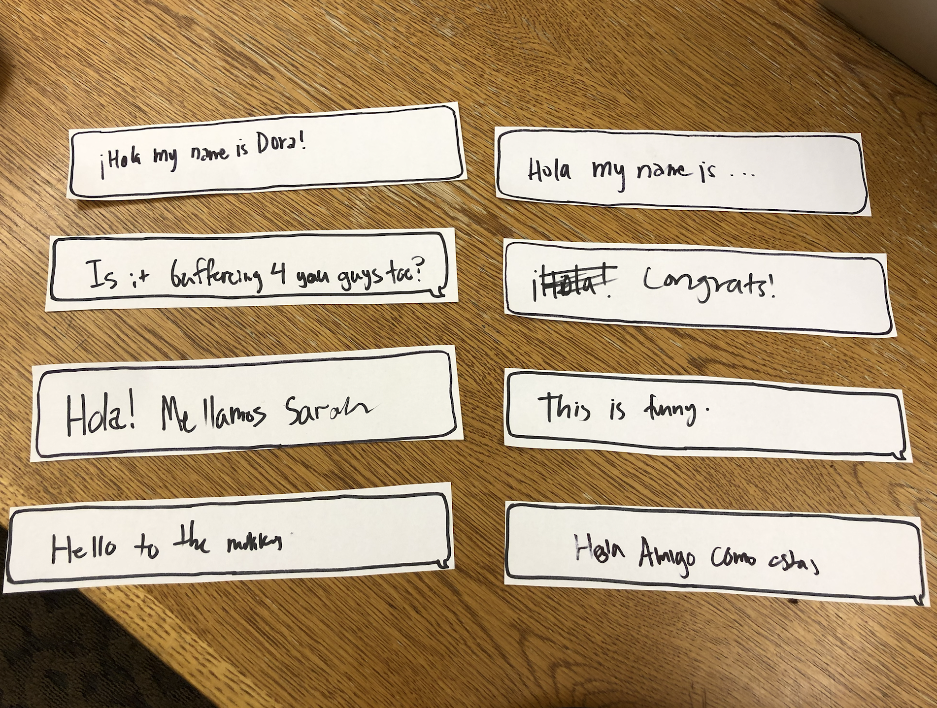
Prototype

Slide 29
Procedure
Use the Mora app to complete our 3 tasks while watching clips of Dora the Explorer*.
* chosen to be accessible to any level of user.

Slide 30
Procedure
Facilitator: (Lulu/Tommy)
Introduce the basic concept of Mora
Demo the mechanisms of a paper prototype
Explain the goal of a task
Ask the participant to achieve the goal while thinking aloud
Ask for feedback generally and on metrics after each task and at the end
Computer: (Candy/Bryant)
Replace paper screens as buttons are pressed
Transcribe chats the user wants to send
Emulate haptic feedback with sound effects and shaking the screen
Control the video that the participant is watching while using Mora
Notetaker: (Tommy/Bryant)
Track misclicks
Note any critical incidents
Transcribe feedback from and thoughts of the participant

Slide 31
Goals & Metrics
Fun vs Avg language learning
Eagerness to use app (Generally and each task)
Intuitive navigation
1-5
(1: disinterested, 3: neutral, 5: super interested)
1-5
(1: much worse, 3: same, 5: much more fun)
# misclicks per task
Notes:
Other ideas: time to complete task, language retainment
Failed because wanted to talk and make comments during task
Failed because vocab was too commonly known
Defining misclick: wrong direction for task (only initial error counted), pressing things that are not buttons

Slide 32
Results!

Slide 33
Critical Observations
All users did not initially understand the pair to screen button
Vanessa and Bill could not identify arrow buttons as a way to move forward
Vanessa, Bill, and Tony wanted Dora to speak only in the target language
Vanessa and Bill both incorrectly thought that the lesson screens were interactive and tried to click them
Tony quit the app out of disinterest
Notes:
More critcial

Slide 34
Generative Observations
Vanessa and Bill spoke out loud while reading the lesson
Blaine loved the examples of how to use the words
Vanessa and Blaine frequently used the chat function but… Vanessa and Blaine both said they would rather learn on their own (contradiction!)
Tony would have been more interested with a different show
Blaine wanted more competition and games

Slide 35
Metrics
 | Eagerness 🆗 | Fun 🆗 | Misclicks 🆗
Vanessa | 1 | 1 | 0
Bill | 5 | 5 | 11
Tony | 2 | 3 | 5
Blaine | 4 | 4 | 1
Notes:
Kind of met all of our goals — had very extreme reactions either way

Slide 36
Results
Interested
Incapable and interested.
Bill
Blaine
Capable and Interested.
Incapable
Capable
Incapable and uninterested.
Tony
Vanessa
Capable and uninterested.
Uninterested

Slide 37
Results
Interested
“If an old guy like me can deal with [this interface], so can anyone!”
Bill
“I kinda wanted more learning, but other than that it was perfect!”
Blaine
Incapable
Capable
“I would probably exit the app now.”
Tony
“I didn’t learn anything, so I guess I should go home.”
Vanessa
Uninterested

Slide 38
Eagerness to use each task
Solo watch
3
Review
3.5
Watch Party
2.75
Notes:
Eagerness to use
Watch party points lost frequently because people were “anti-social”

Slide 39
Process data → Implication
Dora the Explorer: Using a show with such basic vocab was not enjoyable to our users.
Our user should be able to customize language difficulty so that more advanced users can watch a show entirely in their target language.

Slide 40
Process data → Implication
Users felt like they did not get enough language content.
We should include more frequent and complex language lessons throughout.

Slide 41
Process data → Implication
Multiple users did not understand meanings of buttons.
We should include more descriptive and/or intuitive buttons.

Slide 42
Design ideas
Add subtitles to buttons
Particularly rephrase “Pair to Screen”
Add race element to watch party to increase competitive engagement
Incorporate grammar lessons to increase complexity

Slide 43
Shortcomings of Test
No choice in watching show
Couldn’t reveal how long people would be willing to watch the show
Couldn’t engage with other real users

Slide 44
Thanks!
Do you have any questions?

Slide 45
Appendix!

Slide 46
Phone pros
haptic experience uses multiple senses
async learning is portable
chat is on phone, which is where people are used to going for a chat
Typing is fast and familiar
a lot of people ARE actually accustomed to doing things on phone and TV at same time
could pair to laptop, tablet, TV -- lots of choice
can sync multiple phones to same streaming device -- adds in person social element as well

Slide 47
Phone cons
Need to have bluetooth connection/access to a device that can pair with phone
accessibility of access to 2 smart devices
looking down at phone distracts from TV experience
looking at 2 things at same time
small screen prevents more innovative learning experiences
excludes non smartphone users

Slide 48
Tablet pros
only one screen to see all options -- easier to remember to take advantage of chat, etc
can have more innovative or game-ified learning experiences with more screen space
stylus experience optimized for handwriting, which helps retain memory through tactical, multi-modal engagement and is extremely useful for character-based languages
separate from the distractions of a phone (which is associated with work, friends, social media) and uses associations of fun/gamieness of tablet?

Slide 49
Tablet cons
only one screen can lead to crowded/busy UI
tablet is less accessible (less people have them)
tablet is less natural to carry around for async
and language learning needs to be pretty regular
less choice on how to watch TV-- must watch on tablet, which would maybe be less habitual
and tablet less social -- can’t do in group setting
typing on tablet is really difficult and not well built by Apple etc --- limits ease of chat and typed language answers

Slide 50
Changes made post check-in:
Added chat/results toggle
Created additional lesson so that solo watch and watch party were different videos

Slide 51
Participants (cont.)
Recruited around campus, asking around if people were willing.
Compensated by keeping in touch on our project.
Demographics: all late twenties to mid sixties, two white people, two east asian people, 1 woman, 3 men.
Environment: outside at white plaza or inside at tresidder marketplace
Apparatus: our paper prototype.

Slide 52
SCRIPT for facilitator in test
instructions: using this app to language learn while you watch TV
candy will be computer, so she is just making these papers work like the technology would
and tommy is our note taker
neither of them will speak so that you can ignore their presence as much as possible
I will be asking you for your thoughts as you walk through the app, but I won’t help you navigate anything so that we can see your natural instincts.
demo: show them that this is your phone for they day, they can click buttons, to type they can click letters while speaking them out loud, when we shake paper it means the phone is vibrating
3 scenarios:
you are watching tv by yourself and you want to take advantage of the time to learn target language
you want to review the vocab you learned previously
you want to have a more social learning experience with people who watch the same show as you and start a watch party
wrap up: ask for both ratings, any final questions or thoughts they have, what did they like/dislike

Slide 53
Critical Incidents: Vanessa
Incident | Severity
Vanessa: Didn’t realize possibly that the buttons were buttons | 1
Vanessa: Didn't know what she was supposed to DO with the lesson – “I should say ‘me llamo sarah? I know english, so I should repeat it in English” | 3
Vanessa: Didn’t understand the language choice for media/lessons – “I want the next lesson because it’s not in english” | 0
Vanessa: Didn't fully understand the concept of pair to the screen – “Shouldn’t it stay paired” | 3
Vanessa: Did not realize immediately that she should type review answers – “Oh i’m supposed to type it” | 1
Vanessa: When the “bienvenidos” lesson popped up, she said I didn't hear that but maybe because we were outside | 2
Vanessa: Did not want to go to chat – “I probably wouldn't go chat because I am anti-social” | 0
Vanessa: She suggested there be subtitles | 3
Vanessa: Felt the flow from home to watch party felt natural | 0

Slide 54
Critical Incidents: Bill
Incident | Severity
Bill: For the first task he began with chat and ended exploring review and pair to screen | 4
Bill: Went to wrong page for first task | 4
Bill: Felt encouraged to chat | 0
Bill: Long hesitation on the lesson page | 2
Bill: Thought speaker button saying the vocab word was asking him to repeat back the word | 1
Bill: Smiled as he went between chat and show | 0
Bill: Engaged with TV Show – “It’s a fiesta” | 0
Bill: Didn’t notice next button on stats page | 1
Bill: Thought being sent back to vocab lesson from stats page meant he made an incorrect selection | 2

Slide 55
Critical Incidents: Tony
Incident | Severity
Tony: Chose chat for first task instead of pair to screen | 4
Tony: Never reached the pair to screen, did not feel intuitive to select it | 4
Tony: “I guess dora” – was very disappointed with media selection | 2
Tony: pressed the back button and left dora twice | 2
Tony: Did not feel educational aspect was clear | 3
Tony: “I really don’t know what’s happening right now. It’s totally off, that’s how I feel right now, I think I am just gonna quit the app now” | 4
Tony: Chose chat for first task instead of pair to screen | 4
Tony: Never reached the pair to screen, did not feel intuitive to select it | 4
Tony: “I guess dora” – was very disappointed with media selection | 2

Slide 56
Critical Incidents: BLAINE
Incident | Severity
Blane: Didn’t think language learning was clear from home screen | 1
Blane: Thought review button led to tutorial - but he left the review section when he realized it wasn’t a tutorial | 2
Blane: “Oh I understand the app” | 0
Blane: He liked the example sentences | 0
Blane: Did not click the first sound button for “hola”
Blane: Understood the flow of the app – “Ok so here comes the quiz” | 0
Blane: Loved the positive reinforcement check mark after getting answer correct – “Positive, very good, nice” | 0
Blane: Had inclination that word on stats page was clickable and would lead to review page – “Can I click on this” | 0
Blane: Expected more new material before quiz – “I was expecting something new to learn but was instead already a quiz” | 2

